Slide 1



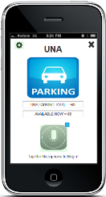
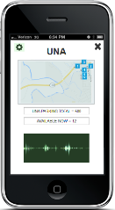

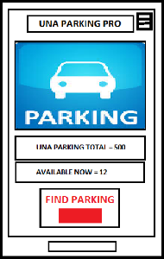




UNA Parking Pro
Hussain Alhashim | Kirk Kratohvil | Luke Peterson | Kristina Trzaskoma, University of North Alabama
Introduction
Analysis
Implementation
Finding a parking space in general can be one of the most frustrating tasks a person faces when going to work or attending school. In the case of finding parking at the University of North Alabama, that issue is a reality.
We tested our prototype interface with ten individuals. Their goal was to navigate past the home page and then use the voice command feature to find an available parking spot in the GUC parking lot.
Feedback
Results
Was the task achieved: 100% yes
Hardest task: Guessing voice command lines
Best feature: Voice command
Average rating: 7/10
After implementing features and making changes that our users advised us to consider, we’ve made the interface more user friendly by enhancing the features of the voice command and by providing a library of voice command lines for the user to view. These changes have improved the user experience for the interface as a whole.
We have developed an interface that will allow students who attend the University of North Alabama to find available parking spaces. The goal of this interface is to ensure students are able to easily find parking spaces. This will save them time and help to prevent them from being late to a class or meeting.
The ten individuals had many problems and suggestions from the start after attempting the task. The main problem was not knowing what to say once the voice command was activated, while the main suggestion was to have the voice command feature displayed on the homepage.

Slide 2
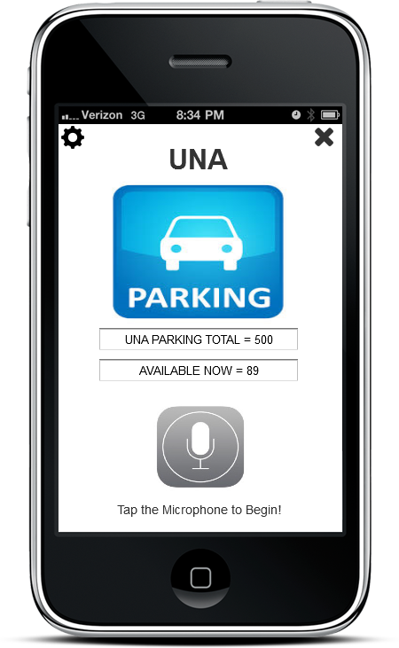
UNA PARKING PRO
Find Parking
Options
Close Application

Slide 3
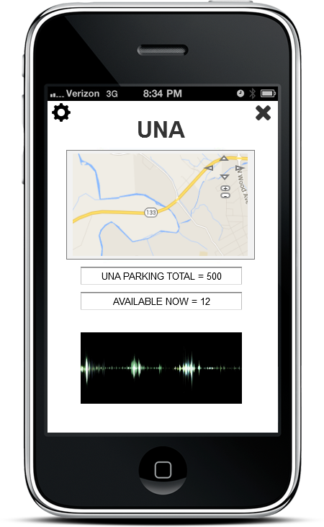

Zoom 1
Zoom 2
Zoom 3
Find Parking?
Say: Yes, or at any time Say: No thanks.

Slide 4
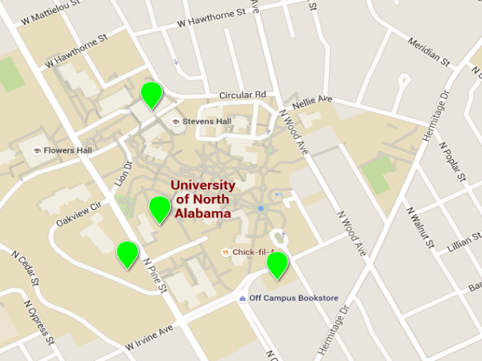
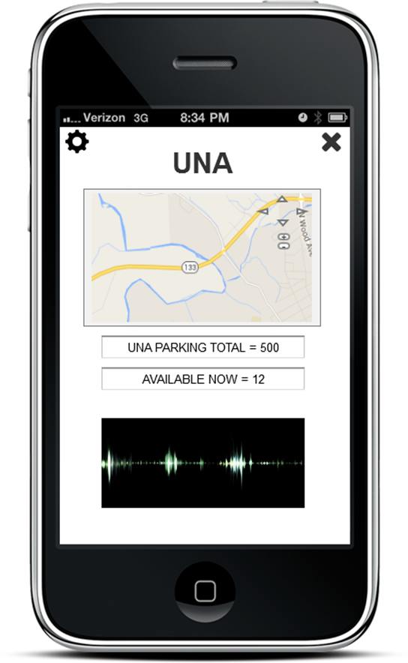
Zoom 1

Slide 5
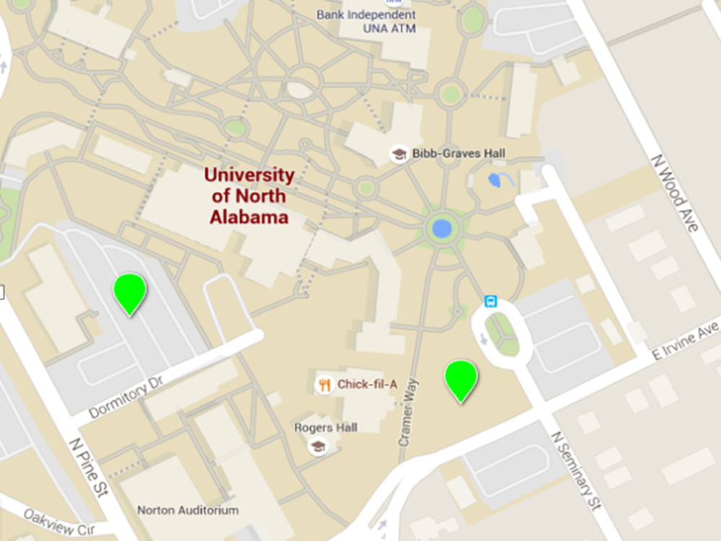

Zoom 2

Slide 6
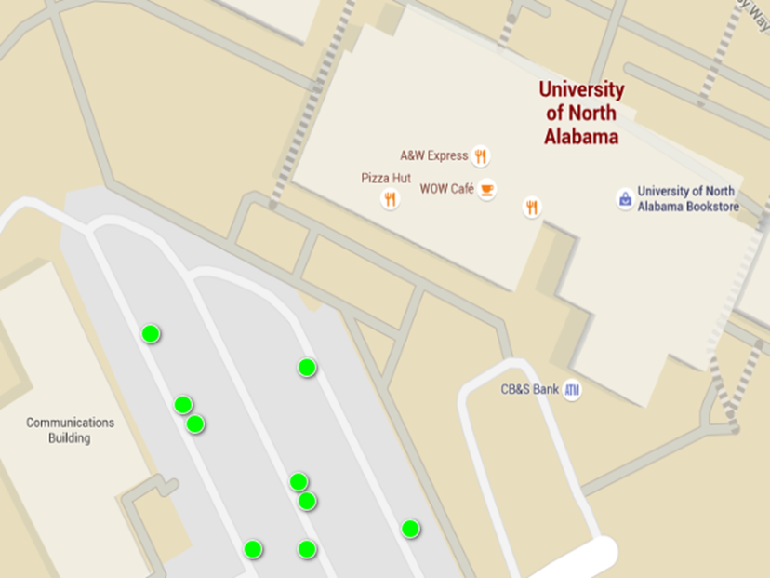
Zoom 3

Slide 7


Find Parking? Yes
Say: Where can I park?
“Where can I park?”

Slide 8


Where can I park?
Current Parking is Available at:
‘The GUC’
Say: Show me
“Show me.”

Slide 9

Show Me
If you need to return to the home screen, just say:
‘Home’

Slide 10
Options
Voice Settings:
Male Voice Accent – French, Spanish, Russian, Italian Female Voice Accent – French, Spanish, Russian, Italian
Voice off (will accept user voice commands only) Voice off (no voice commands / not recommended)
Exit
Exit

Slide 11
Close Application
Are you sure you want to exit?
Yes / No
No

Slide 12
Application Closes

